Slide 1
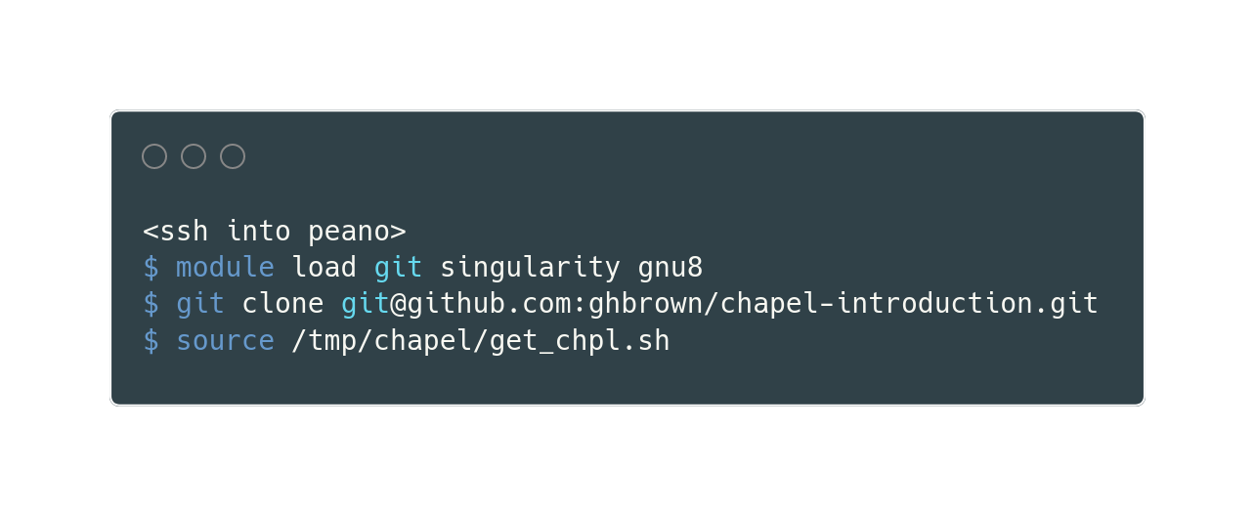
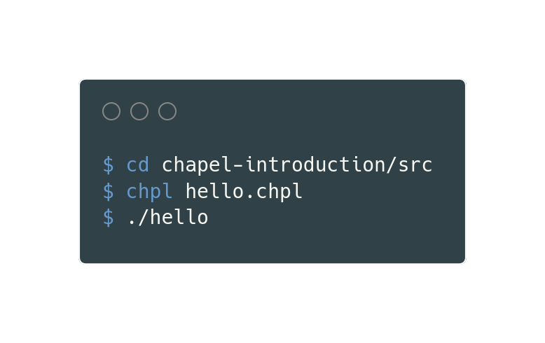
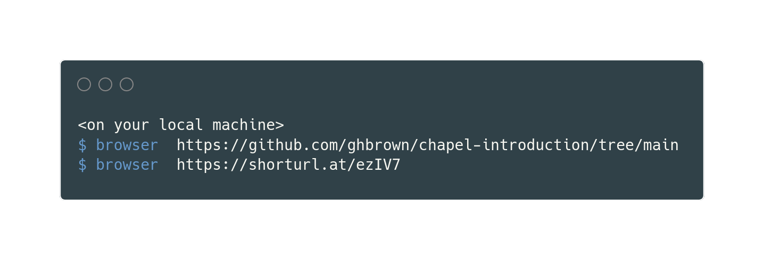
Setup
Get Chapel on Peano, then try a program
or

Slide 2
Chapel Parallel Programming Language: a user introduction

Slide 3
History
Cray’s entry into DARPA’s High Productivity Computing Systems project
  “there exists a critical need for improved software tools, standards, and methodologies for effective utilization of multiprocessor computers” – Lusk and Yelick, 2007
A language for high performance and productivity parallel programming
Development now continued at HPE

Slide 4
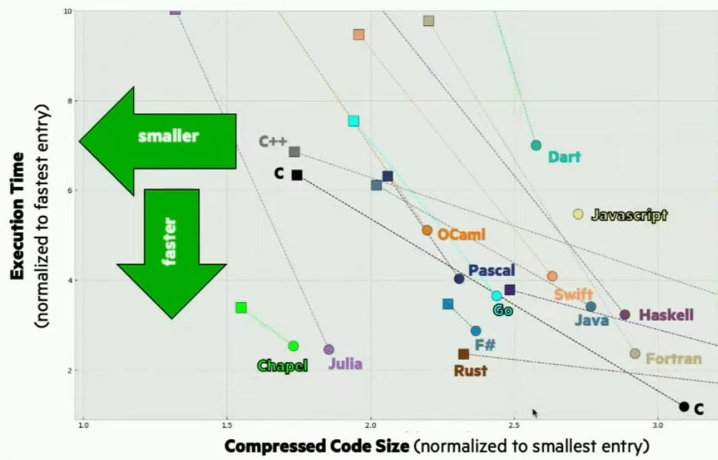
Motivation: language benchmarks
source

Slide 5
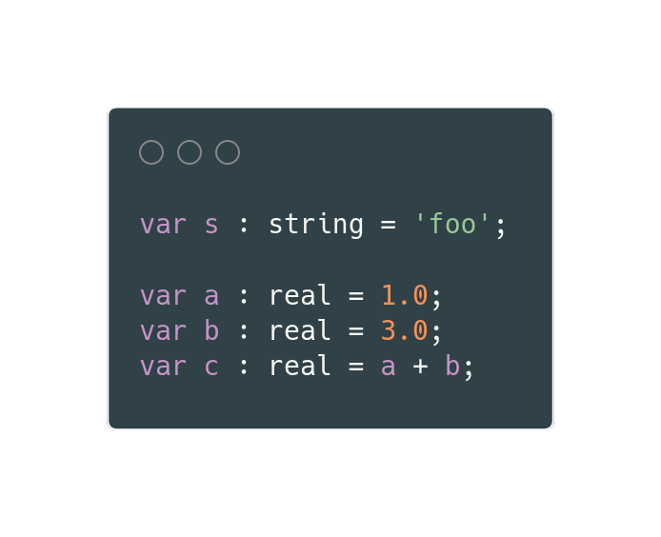
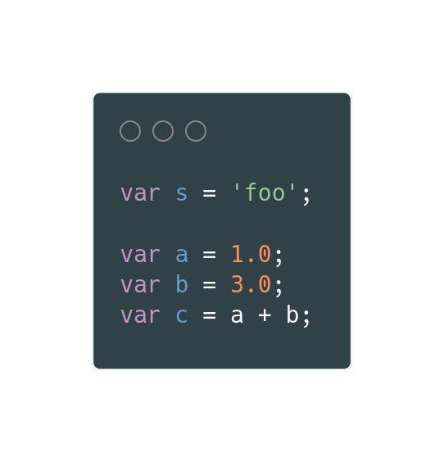
Chapel: serial language features
static typing (with type inference)

Slide 6
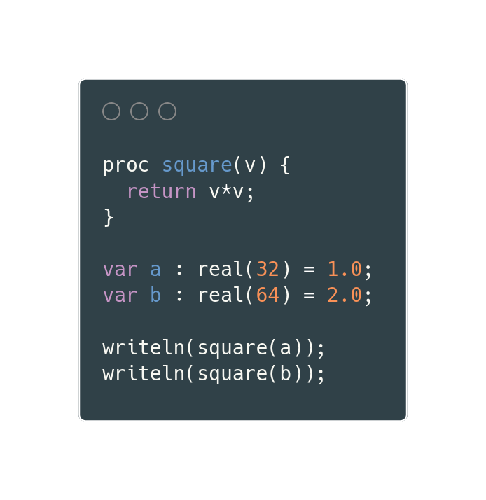
Chapel: serial language features
generics
  functions can work for multiple input types
  not present in C or Fortran (without interfaces)

Slide 7
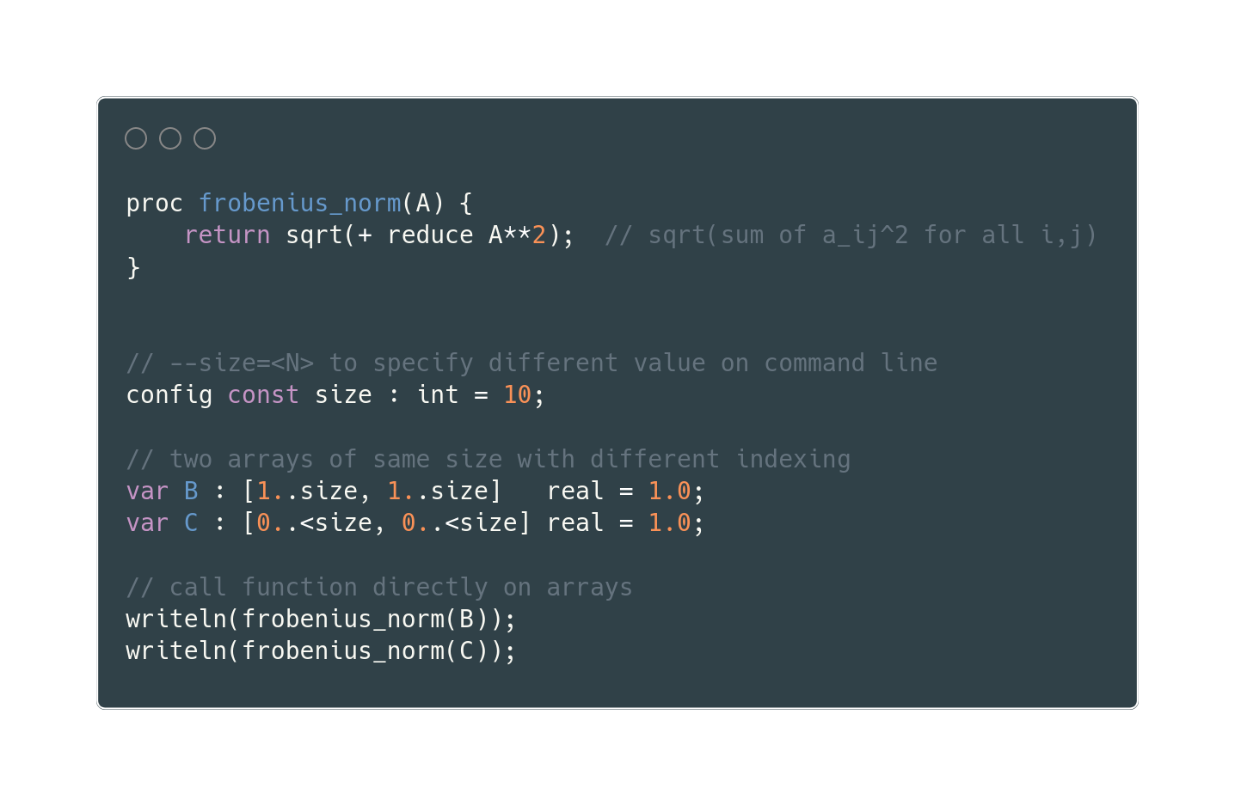
Chapel: serial language features
first class arrays (with fancy indexing)

Slide 8
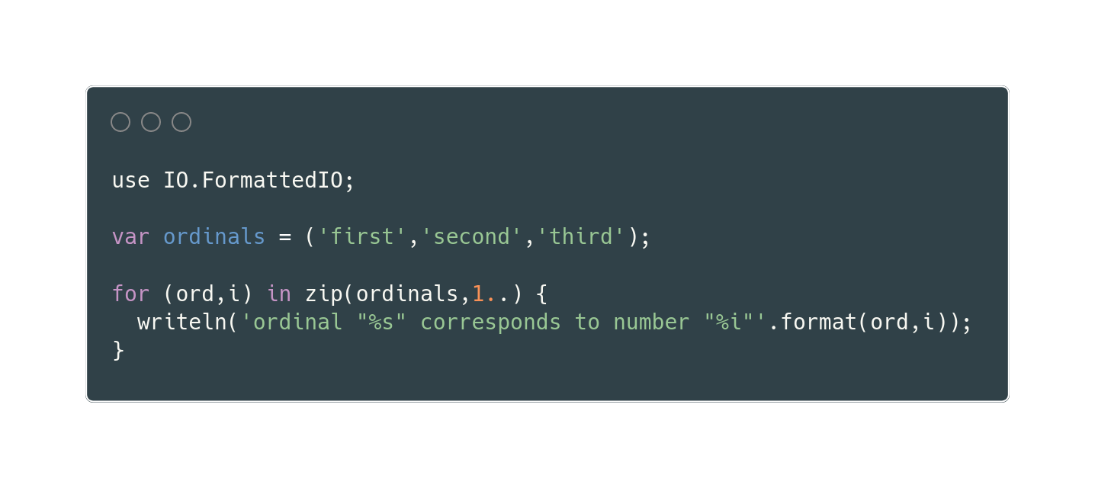
Chapel: serial language features
iterators and zipping

Slide 9
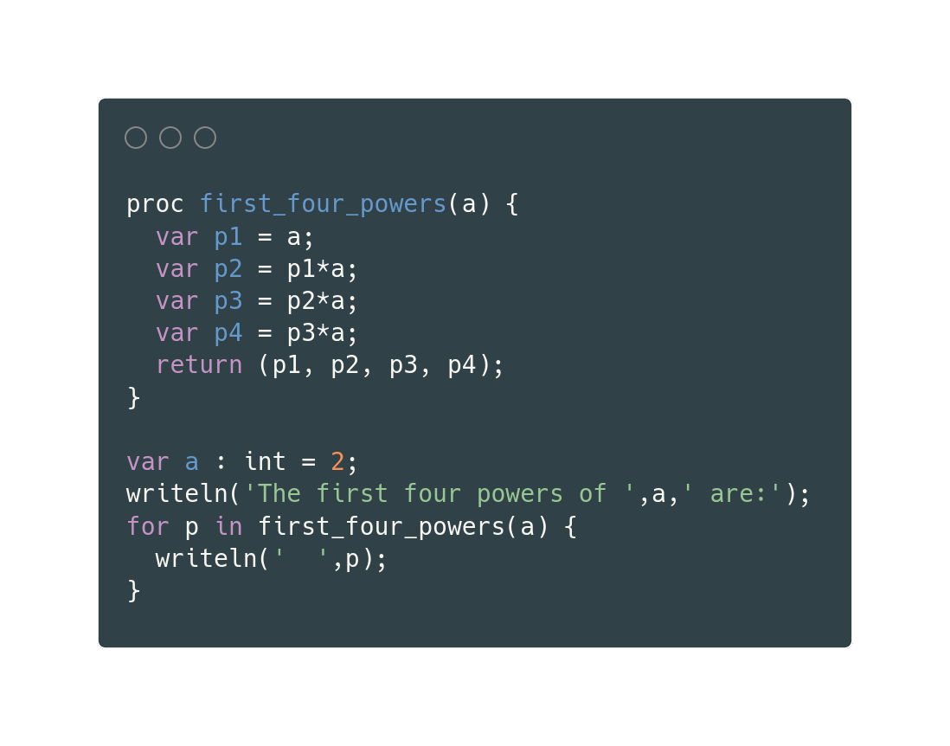
Chapel: serial language features
Also:
  multiple outputs
  default arguments
  objects

Slide 10
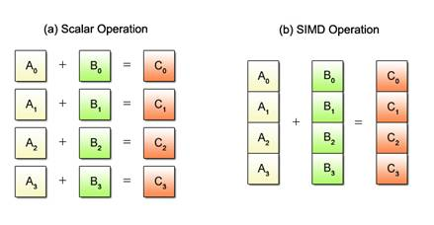
Parallel programming models: SIMD
single instruction multiple data
  gives up flexibility for speed
  CPU instructions like addpd
  contributes to performance of Numpy and GPUs
source

Slide 11
Parallel programming models: SPMD
single program multiple data
  retain flexibility for program complexity
  same program runs on every node, doing possibly different things simultaneously
  MPI is dominant standard in HPC, designed for distributed memory
# send vector in chunks to other nodes
if (node == 0):
for i in [0,…,n_nodes]:
MPI_SEND(a[8*i:8*(i+1)])
MPI_SEND(b[8*i:8*(i+1)])
# all nodes receive chunks
MPI_RECEIVE(a_local)
MPI_RECEIVE(b_local)
c_local = a_local + b_local
if (node == 12):
print(“I’m node 12.”)
...

Slide 12
Parallel programming models: directives
Serial code annotated with directives for compiler
  OpenMP and OpenACC both work for CPUs and GPUs
  preserves portabilty (AMD vs Intel, Nvidia vs AMD)
  often combined with MPI
#pragma omp parallel for
for(int i=0; i<ARRAY_SIZE; i++)
c[i] = a[i] + b[i];
}
Note: “directives” summarizes a way of interacting with source code, but the directives themselves can do many things, including SIMD on CPUs or GPU kernels

Slide 13
Parallel programming models: PGAS
Partitioned Global Address Space
  global address space: threads can read/write remote data
  partitioned: data designated as local versus global
  examples: Unified Parallel C, CoArray Fortran, Chapel
MPI: isolated processes with isolated memories exchange messages
OpenMP: multiple threads can read and write a shared memory
PGAS
virtually global address space realized across distributed hardware with non-uniform memory access times
compiler uses program as specification to map processes to hardware
source 1
source 2

Slide 14
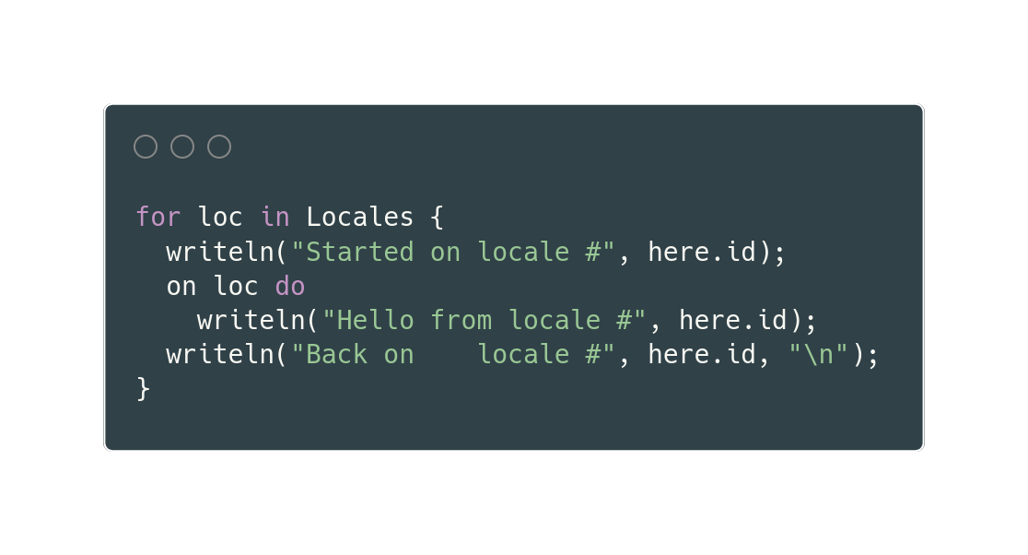
Chapel: locales
Resources with compute and memory
  most naturally a (many core) compute node
Resources with compute and memory
  most naturally a (many core) compute node
Hierarchical:
  may contain sublocales (like GPUs)
*this is not a parallel program

Slide 15
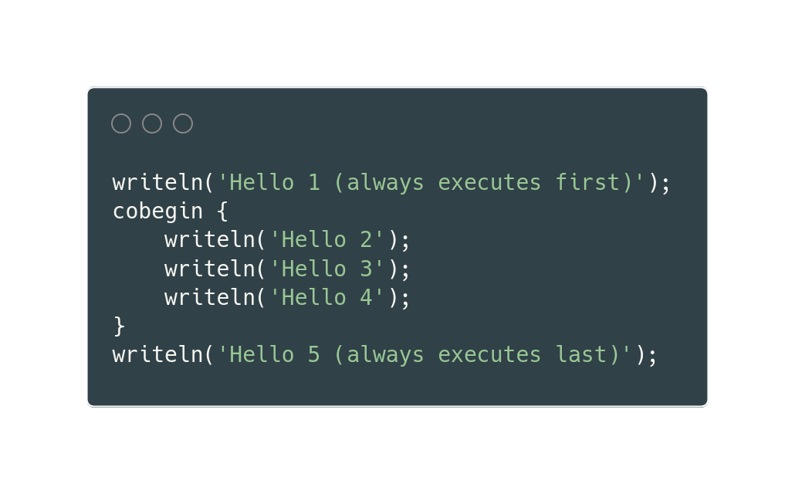
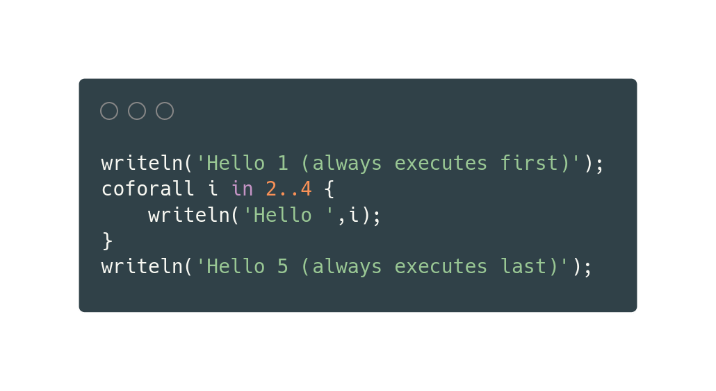
Chapel: task parallelism
begin:
  fork one non-blocking process
cobegin
  fork one process per statement, blocking
coforall
  fork one process per iteration, blocking

Slide 16
Chapel: data parallelism
forall

Slide 17
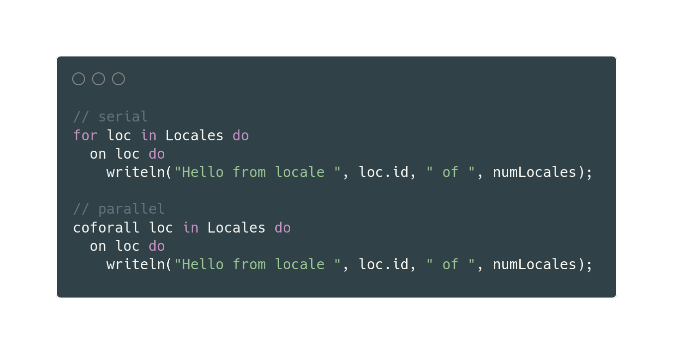
Chapel: orthogonality of locality and parallelism

Slide 18
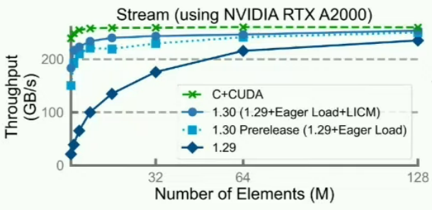
Chapel is ready for prime time, but...
compile times
tooling
hardware
packaging
availability on HPC systems
source

Slide 19
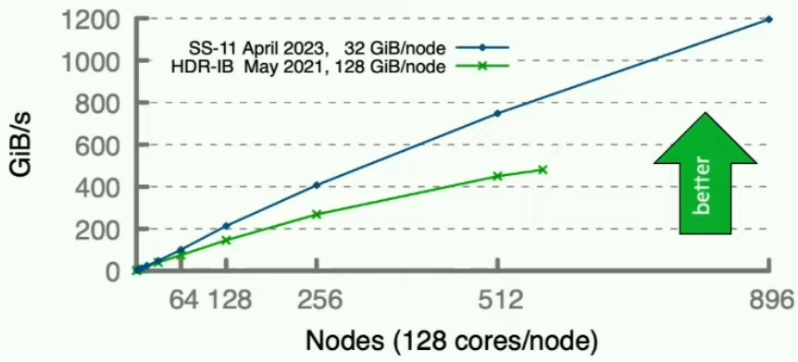
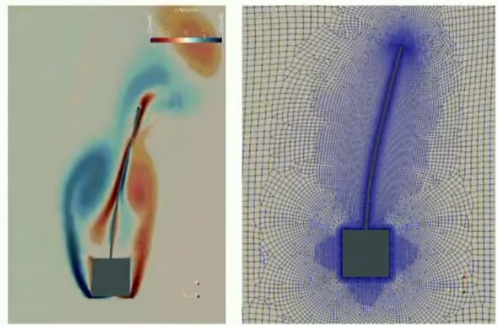
Success stories
Sorting:
  (near) world record performance in 100 lines of Chapel
CHAMPS
  3D unstructured CFD, airplane simulation
  “students take 3 months to do what used to take 2 years”
source

Slide 20
Wrapping up
Could not cover:
  language interoperability: C, Fortran, Python
  iterators, ranges, (sparse) domains, distributions, layouts
  GPUs
Resources:
  Learn Chapel in Y minutes
  Official Cray/HPE talk on Chapel
  Online compiler

Slide 21
Working outline
History of Chapel
Language basics
  C style syntax, statically typed (with type inference)
  goodies: zippered iteration, domains (0 vs 1)
  benefits over Fortran: generics, multiple outputs
  benefits over C: first class arrays, pointers rarely needed (more common for C interoperability)
Programming models for parallel computers
  SPMD (MPI), directives (OpenMP), PGAS

Slide 22
Working outline 1.5
Locality
Task parallelism (begin, cobegin, coforall)
Data parallelism
Orthogonality of locality and parallelism

Slide 23
Working outline 2
Cons: compile times (getting fixed), tooling, pace of development (e.g. GPUs, show Nvidia plot from LinuxCon talk), packaging, distributed setup (running on multiple DOE systems, not default)
Success stories: sorting (get bandwidth and lines of code), coastline thing from CHIUW 2023, CHAMPS
Things I didn’t have time to discuss: language interoperability (C, Fortran, Python), domains (helpful operations like interior, etc.), sparse domains and arrays (whole framework, not just CSR, etc.)

Slide 24
Working outline 3
Resources

